Slide 1
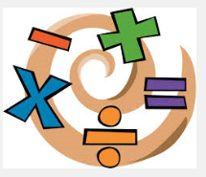
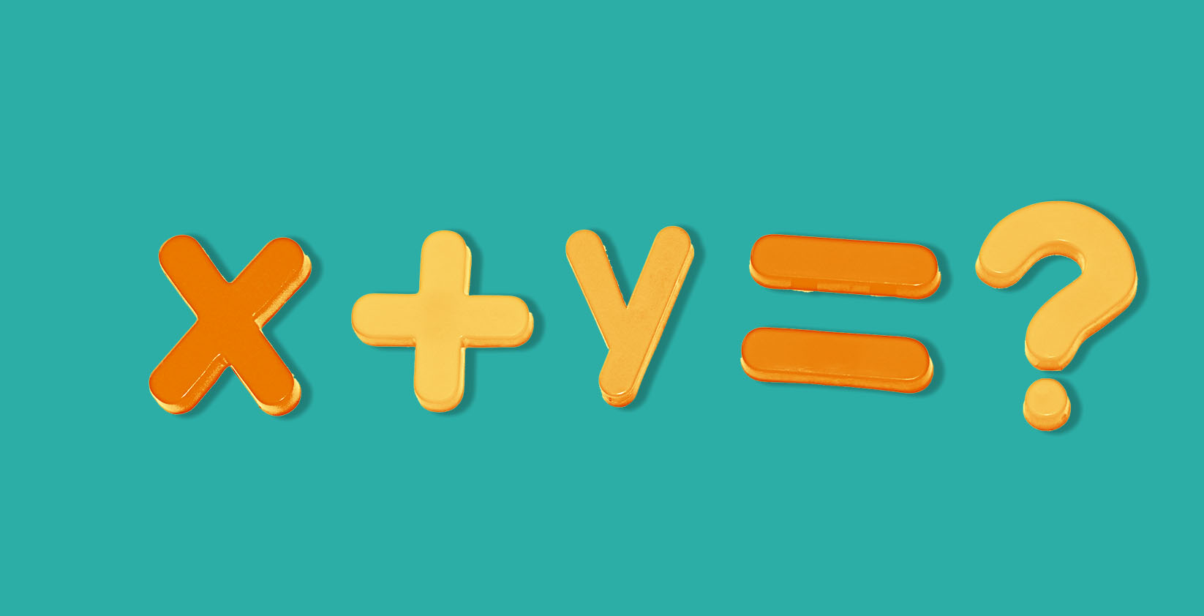
Chapter 6
Introduction to algebra

Slide 2
Content
Objectives
A Brief History about Algebra
Introduction
Algebraic Expressions
Activity 1
Terms - Like and Unlike Terms
Variables and Constants
Coefficients
Rules of Operations of Algebraic Expressions
Addition of Algebraic Expressions
Subtraction of Algebraic Expressions
Evaluation of Algebraic Expressions
Activity 2
Summary

Slide 3
Objectives
To enable students to:
• Understand the language of algebra (use of letters of the alphabets to represent numbers).
• Understand Variables.
• Differentiate between Variables & Constants.
• Form an algebraic expression.
• Identify the like and unlike terms.

Slide 4
Objectives
To enable students to:
• Know the number of terms in an algebraic expressions.
• Substitute numbers for letters of the alphabet in expressions and formula.
• Find out the addition of algebraic expressions by horizontal and column method.
• Find out the subtraction of algebraic expressions by horizontal and column method.
• Evaluate the algebraic expressions by substituting the given value.

Slide 5
A Brief History About Algebra
Algebra began its journey as a branch of Mathematics around 1550 BC (around 5500 years ago) with people in Egypt using symbols to denote unknown numbers.
The word ‘algebra’ is derived from the title of the book ‘Algebar W’al-almugatalah’ written about 825AD by an Arab mathematician Mohammed Ibn Musa Al Khwarizmi of Baghdad.
Indian mathematician Aryabhatta is said to have introduced Algebra in India.
The first person to develop algebraic method of problem solving was the French mathematician Francois Viete. He is also called the “Father of Algebra”.

Slide 6
What is Algebra?
The part of the mathematics in which letters and other general symbols are used to represent numbers and quantities in formulae and equations.

Slide 7
6 + q = 10
q = 4
Can you solve?
2 + x = 10
x = 8
So letters in Maths are just missing numbers.
When letters of alphabet represent numbers, they are called Literal Numbers.

Slide 8
Try this yourself!
Use algebra to write:
2 less than x
4 more than d
6 together with a
y more than g
z less than q
m less than 5
x – 2
d + 4
a + 6
y + g
q - z
5 - m

Slide 9
What is Algebraic Expression?
A combination of numbers, literal numbers and the fundamental operations is called an Algebraic Expression.
Example:
5x + 3y – 4 → 5x, 3y and 4 are the parts separated by the symbols (+) and (-) signs.

Slide 10

Activity - 1
How many sweets are in this bag?
n

Slide 11
We don’t know!
We have to call it ‘n’ for any number!
n

Slide 12
How many sweets are here??
3 bags of n and 2 more!
We write this as
3n + 2
n
n
n

Slide 13
Now, write the expression for the number of sweets in the picture given below.
n
n
n
n
n
n
Ans → 6n + 5

Slide 14

Parts of An Algebraic Expression

Slide 15

Term
$$3x−2y+7$$
What is a Term?
Parts of an algebraic expression separated by the symbols (+) and (-) are called the Terms of an algebraic expression.

Slide 16
Terms
LIKE TERMS
Terms having the same variables.
Examples →
4x, 7x , -2x
They have the same variable ‘x’ and therefore are like terms.
UNLIKE TERMS
Terms having different variables.
Examples →
7x , -5y , 5x²
They have different variables (such as x,y,x²) and therefore are unlike terms.

Slide 17

Variables
$$3x−2y+7$$
What is a Variable?
A variable is a symbol which represents a quantity that can change.

Slide 18

Constant
$$3x−2y+7$$
What is a Constant?
A quantity which does not change its value is called Constant.

Slide 19
Coefficients
$$3x−2y+7$$
What is a Coefficient?
The number that is multiplied by the variable is called Coefficient.

Slide 20
For the expression: 7x + 3y – 9
Name:
    1. a term
2. the constant
3. a coefficient
4. a variable

Slide 21
For the expression: 7x + 3y – 9
Name:
    1. a term 7x or 3y or -9
2. the constant -9
3. a coefficient 7 or 3
4. a variable x or y

Slide 22
NAMES OF
Algebraic ExpressionS

Slide 23
OPERATIONS ON ALGEBRAIC EXPRESSIONS
Two or more terms can only be added or subtracted if they are like terms.
Unlike terms cannot be added or subtracted.

Slide 24




Addition of algebraic expressions
Jack has some toys, we do not know how many toys he has….
so we can say ‘Jack has x toys’
If Jack buys 6 more toys, how many toys has he now got?
x + 6

Slide 25
Addition of Monomials
Like Terms
Example:
Add 5x, 4x and 3x
5x + 4x + 3x = (5+4+3)x
= 12x
(Adding numerical coefficient of each monomial)

Slide 26
Addition of Monomials
Unlike Terms
Example:
Add 4x, 2y, -y and 3x
4x + 2y + (-y) + 3x
= (4x + 3x) + (2y – y)
= 7x + y
We have unlike terms
Regrouping like terms

Slide 27
Addition of BinomiAls
Two ways to solve addition of algebraic expressions:-
Horizontal Method:
Column Method:

Slide 28
1. Horizontal Method
In this method, all expressions are written in a horizontal line and then the terms are arranged to collect all the groups of like terms and then added.
Example:
(3x² + 5x – 3) + (x² – 5x + 1)
= 3x² + 5x – 3 + x² – 5x + 1 (remove the brackets, identify the like terms)
= 3x² + x² + 5x – 5x – 3 + 1 (group the like terms together)
= 4x² + 0 - 2
= 4x² – 2 (Ans.)

Slide 29
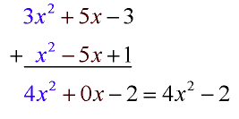
2. Column Method
In this method each expression is written in a separate row such that there like terms are arranged one below the other in a column. Then the addition of terms is done column wise.
Example :-

Slide 30

Subtraction of algebraic expressions
Ram catches x fish.
Bharat takes 3 away from him.
How many fish does Ram now have?
x – 3

Slide 31
Subtraction of Algebraic Expressions
The steps for subtraction of algebraic expressions are:
Arrange the terms of the given expression in the same order.
Write the given expressions in such a way that the like terms occur one below the other, keeping the subtracted in the second row.
Change the sign of each term in the lower row from + to – and – to +.
With new signs of the terms of lower row, add column wise.

Slide 32
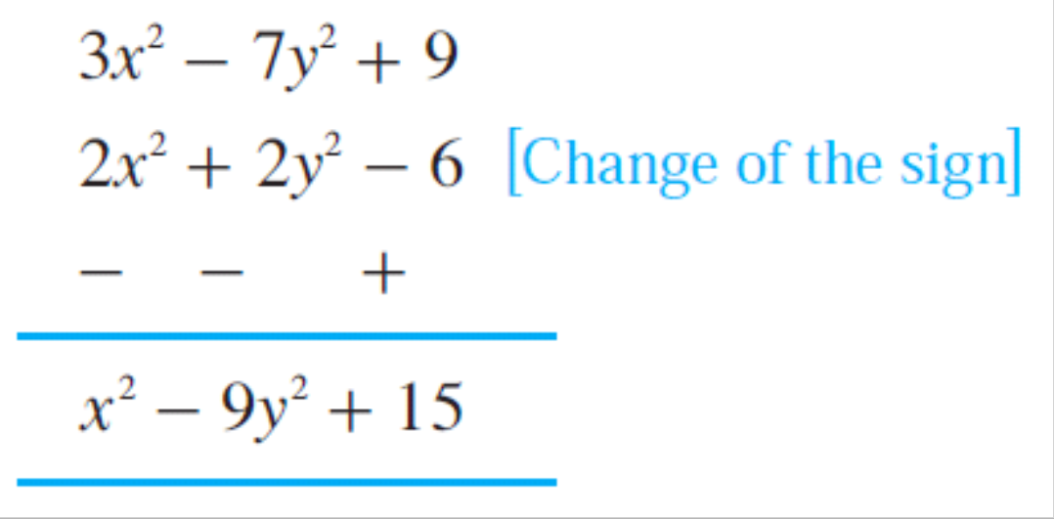
Example of Subtraction
(2x² + 2y² - 6) from (3x² - 7y² + 9)
Horizontal Method
(3x² – 7y² + 9) - (2x² + 2y² - 6)
= 3x² – 7y² + 9 - 2x² - 2y² + 6
= (3x² - 2x²) + (– 7y² - 2y²) + (9 + 6)
= x² – 9y² + 15
2. Column Method

Slide 33
Try it Yourself !
4a – 5a² + 2a + 3a² =
2) 5a + 2b – 10a – 3b =
3) 3y – 4x – 5y + x =
4) -4x² + 7x – 10x² =
5) r² + 2r – 7r² – 7r² – 2r =
6a – 2a²
- 5a –b
- 3x-2y
7x -14x²
-13r²

Slide 34
Evaluation of Algebraic Expressions
Evaluate means to find the value of an algebraic expression by substituting numbers in for variables.
Example:
What is the value of x + 4 when x = 2?
x = 2
x + 4
= 2 + 4
= 6

Slide 35
If Radha was born in 2002. You can find out what year Radha will turn 18 by adding the year she was born to her age.
In this case, if we add 18 to add to 2002,
2002 + 18 = 2020
Similarly, x can be Radha’s age. Therefore, Radha turns x year old and the expression is given by,
2002 + x.

Slide 36
Evaluate the expression for the given value of the variable:
4x – 3 for x = 2.
4x – 3 for x = 2.
4(2) – 3 Substitute for x
= 8 – 3 Multiply
= 5 Subtract

Slide 37
Try It Yourself!
Evaluate x + 4 for each value of x.
x = 14
x = 83.
2. The expression 7d gives the number of days in d weeks. Calculate the number of days in 52 weeks.

Slide 38
Evaluate x + 4 for each value of x.
x = 14
x = 14
x + 4
= 14 + 4
= 18
Evaluate x + 4 for each value of x.
B. x = 83.
x = 83
x + 4
= 83 + 4
= 87

Slide 39
The expression 7d gives the number of days in d weeks. Calculate the number of days in 52 weeks?
The expression is given by 7d.
In this case, d = 52
7d
= 7(52)
= 364

Slide 40
Activity - 2
1. Think of a number
2. Multiply it by 2
3. Add 10 to the number
4. Divide total by 2
5. Subtract number you picked from total

Slide 41
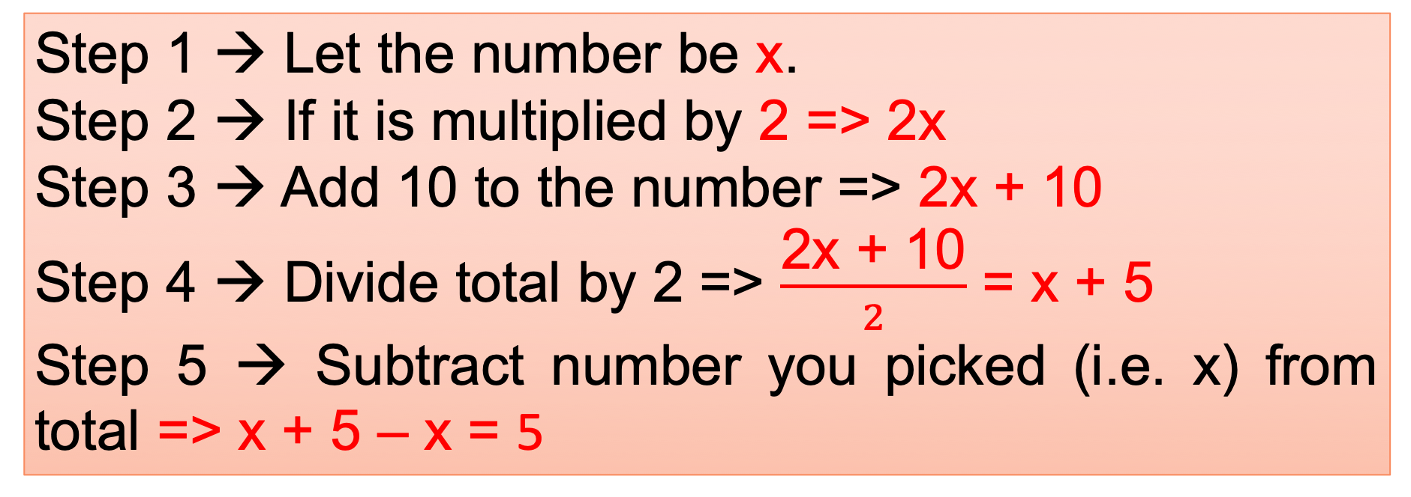
The Answer will be 5 !!!!
Step 1 → Let the number be x.
Step 2 → If it is multiplied by 2 => 2x
Step 3 → Add 10 to the number => 2x + 10
Step 4 → Divide total by 2 =>$\frac{\text{2}\text{x}\text{ + 10}}{2}$ = x + 5
Step 5 → Subtract number you picked (i.e. x) from total => x + 5 – x = 5

Slide 42
Summary
The letters which are used to represent numbers are called Literal Numbers or Literals.
Literal numbers obey all the properties regarding the operation of addition, subtraction, multiplication or division.
Constant is a quantity which does not change its value.
Variable is a quantity which changes its value.

Slide 43
Summary
Algebraic Expression is a combination of numbers, literal numbers and fundamental questions.
Parts of an algebraic expression separated by the symbols (+) and (-) are called the terms.
Terms having same variables are called Like Terms and terms having different variables are called Unlike Terms.
For addition and subtraction of algebraic expression only like terms are to be added or subtracted in both horizontal and column method.

Slide 44
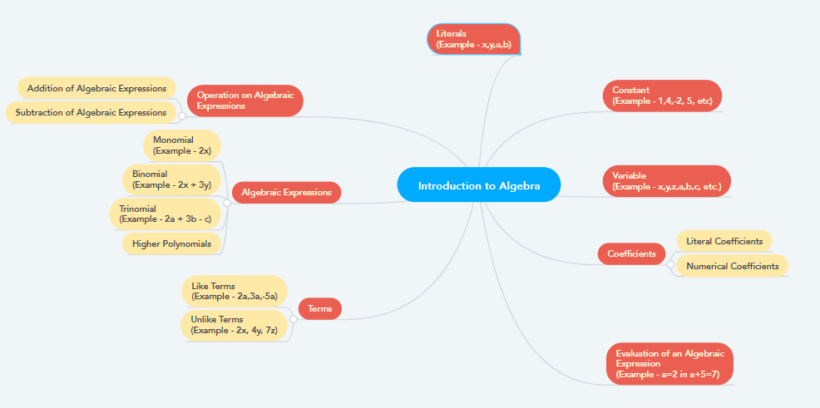
Mind Mapping Diagram

Slide 45
Thank You!

